Slide 1
Data exploration and transformation in Azure Databricks

Slide 2
Agenda
Spark
Describe Azure Databricks
Working with DataFrames
Manipulating and transforming data
Notes:
TALKING POINTS
Let’s set an agenda for today’s presentation in which we are going to discuss these points.
PRESENTER NOTES AND GUIDANCE
Don’t take too much time in order to present the agenda. Make the points in the topics.

Slide 3
Spark
1
Notes:
Move to “Data exploration and transformation in Azure Databricks” presentation

Slide 4



What is Apache Spark?
A unified processing engine to analyze big data with SQL, ML, graph processing, & real-time streaming
SQL / DataFrames
Machine Learning
Graph
Streaming
Notes:
The DataFrames API provides an abstraction above Resilient Distributed Datasets (RDDs) while simultaneously improving performance 5-20x over traditional RDDs with its Catalyst Optimizer.
Spark ML provides high quality and finely tuned machine learning algorithms for processing big data.
The Graph processing API gives us an easily approachable API for modeling pairwise relationships between people, objects, or nodes in a network.
The Streaming APIs give us End-to-End Fault Tolerance, with Exactly-Once semantics, and the possibility for sub-millisecond latency.

Slide 5
Apache Spark
One framework to rule them all.
Spark SQL
Interactive Queries
Spark MLlib
Machine Learning
Spark
Structured Streaming
Stream processing
GraphX
Graph Computation
Spark Unifies:
Batch Processing
Interactive SQL
Real-time processing
Machine Learning
Deep Learning
Graph Processing
Spark Core Engine
Yarn
Mesos
Standalone Scheduler
Spark runs batch and streaming workloads 100x faster than Hadoop
Notes:
Understanding data through data exploration is one of the core challenges faced today by data engineers and data scientists as well. Depending on the underlying structure of the data as well as the specific requirements of the exploration process, different data processing engines will offer varying degrees of performance, complexity, and flexibility.
In Azure Synapse Analytics, you can use either SQL, Apache Spark for Synapse, or both. Which service you use mostly depends on your personal preference and expertise. When conducting data engineering tasks, both options can be equally valid in many cases. However, there are certain situations where harnessing the power of Apache Spark can help you overcome problems with the source data. This is because in a Synapse Notebook, you can import from a large number of free libraries that add functionality to your environment when working with data. There are other situations where it is much more convenient and faster using serverless SQL pool to explore the data, or to expose data in the data lake through a SQL view that can be accessed from external tools, like Power BI.
Spark SQL
Unified data access: Query structured data sets with SQL or DataFrame APIs
Fast, familiar query language across all your enterprise data
Use BI tools to connect and query via JDBC or ODBC drivers
MLlib & SparkML
Predictive and prescriptive analytics
Machine learning algorithms for:
Clustering
Classification
Regression
etc.
Smart application design from pre-built, out-of-the-box statistical and algorithmic models
Spark Streaming
Micro-batch event processing for near-real time analytics
e.g. Internet of Things (IoT) devices, Twitter feeds, Kafka (event hub), etc.
Spark’s engine drives some action or outputs data in batches to various data stores
GraphX
Represent and analyze systems represented by graph nodes
Trace interconnections between graph nodes
Applicable to use cases in transportation, telecommunications, road networks, modeling personal relationships, social media, etc.

Slide 6

When to use Spark?
Look out for these file format challenges…
Invalid file format
Multiple row types
Ragged columns
Row size > 1Mb
Datetime format/s (e.g., use of nanosecond date time)
NULL value literal/s
Free form text
Parquet partitions
XML data
Use of non-standard line delimiters (e.g., CR)
…and try these Solutions
Use Spark to pre-process and fix data errors
Flatten and parse XML in Spark
Use COPY to ingest complex CSV instead of PolyBase

Slide 7






What are my options in Azure?
Spark on VMs
Azure Databricks
HDInsight Spark
Azure Synapse
AKS
Cosmos DB

Slide 9
Describe Azure Databricks
2
Notes:
TALKING POINTS
Let’s go over what Azure Databricks
PRESENTER NOTES AND GUIDANCE
Poll your audience.

Slide 10
Azure Databricks
Fully-managed, cloud-based Spark platform for Big Data and Machine Learning workloads
Empowers developers to accelerate AI and innovation by simplifying the process of building enterprise-grade production data applications
Integrates with Azure Data services commonly used by Data Engineers, including Azure Data Factory, Azure Synapse Analytics, Power BI and Azure Data Lake Storage
Notes:
TALKING POINTS
Fully-managed, cloud-based Spark platform for Big Data and Machine Learning workloads.
Empowers developers to accelerate AI and innovation by simplifying the process of building enterprise-grade production data applications
Integrates with Azure Data services commonly used by Data Engineers, including Azure Data Factory, Azure Synapse Analytics, Power BI and Azure Data Lake Storage

Slide 11
Azure Databricks Environments
Databricks SQL
Databricks Data Science & Engineering
Databricks Machine Learning
Notes:
TALKING POINTS
Azure Databricks is a full-managed data analytics platform optimized for Microsoft Azure. Azure Databricks offers three environments for developing data intensive applications: Databricks SQL, Databricks Data Science & Engineering, and Databricks Machine Learning.
Databricks SQL provides an easy-to-use platform for analysts who want to run SQL queries on their data lake, create multiple visualization types to explore query results from different perspectives, and build and share dashboards.
Databricks Data Science & Engineering (commonly referred to simply as “Workspace”) provides an interactive workspace that enables collaboration between data engineers, data scientists, and machine learning engineers. For a big data pipeline, the data (raw or structured) is ingested into Azure through Azure Data Factory in batches, or streamed near real-time using Apache Kafka, Event Hub, or IoT Hub. This data lands in a data lake for long term persisted storage, in Azure Blob Storage or Azure Data Lake Storage. As part of your analytics workflow, use Azure Databricks to read data from multiple data sources and turn it into breakthrough insights using Spark.
Databricks Machine Learning is an integrated end-to-end machine learning environment incorporating managed services for experiment tracking, model training, feature development and management, and feature and model serving.

Slide 12
Azure Databricks features
Multiple format support
Reading data from CSV, PARQUET, JSON and many others
Integrated with several Azure Data Services
Reading and writing from and to Azure Data Lake Storage, Azure Synapse Analytics, etc.
Notebook experience
Reading and writing by simply writing code in a shared notebook experience
Notes:
Talking points
You can use Azure Databricks in order to read multiple file types, both with and without a Schema. You can read and write from various formats such as CSV, Parquet, and JSON.
In addition to that, Azure Databricks can combine inputs from files and data stores, such as Azure SQL Database, Azure Data Lake storage, and Azure Synapse Analytics.
Within the notebook experience of Azure Databricks, you have multiple language support in order to read and write data by using code you prefer. In addition, you can perform several transformation techniques and store that data for advanced analytics, while working together on the same notebook or workspace.
Instructor notes and guidance
This slide focusses on reading and writing data and the ease to do so in Azure Databricks, as some customers already use Azure Databricks. Call out to the students, that in the lab for this module, they will experience working with Azure Databricks and how reading and writing data with the use of DataFrames works within Azure Databricks.

Slide 13
Working with DataFrames in Azure Databricks
3
Notes:
Talking Points:
Let’s look at how you can query data using DataFrames in Azure Databricks

Slide 14
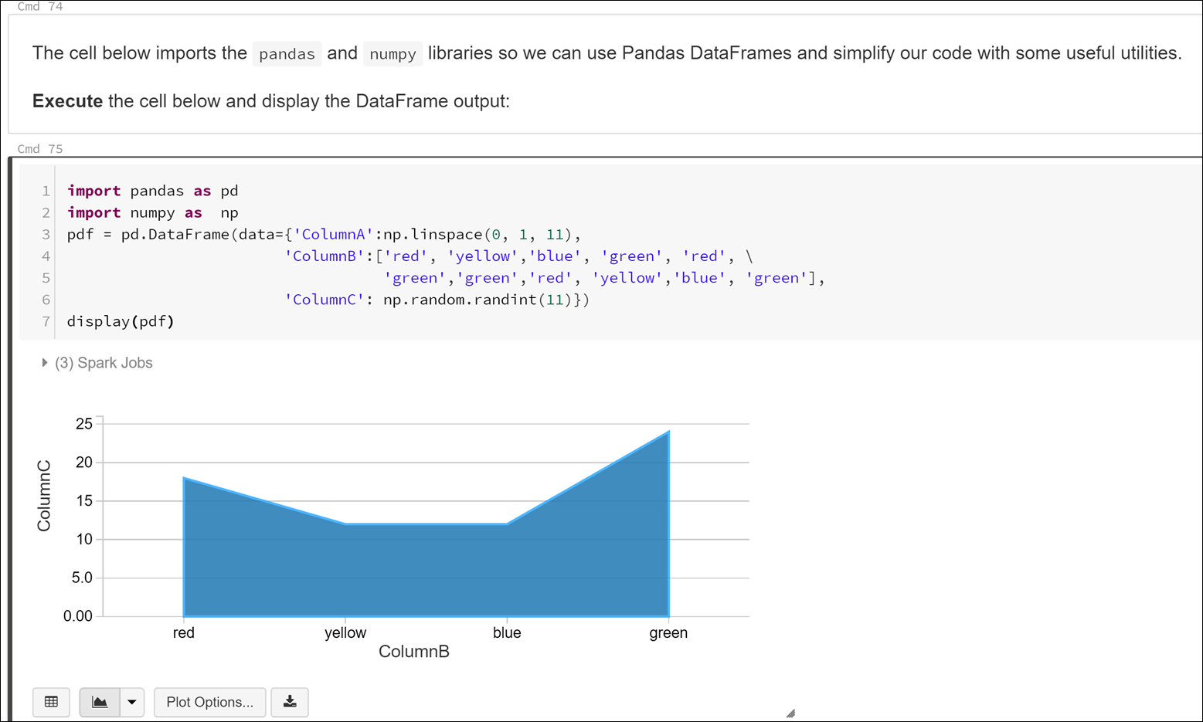
How do we work with Spark: the notebook paradigm
Notebooks are self-documenting and easily shared
They contain a combination of runnable code, output, formatted text, and visualizations
Notebooks are the de facto standard for data scientists and engineers. They can call other notebooks or external libraries as needed

Slide 15
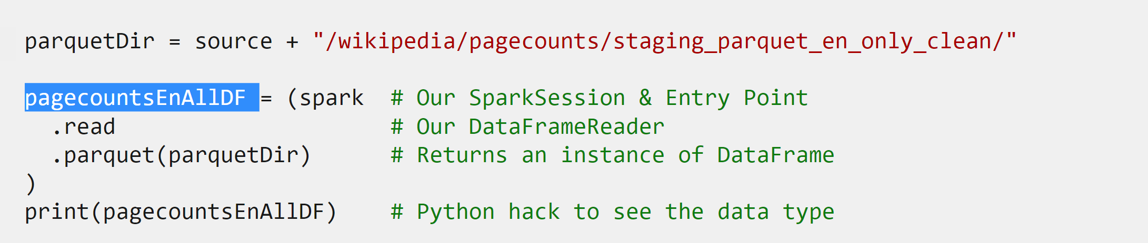
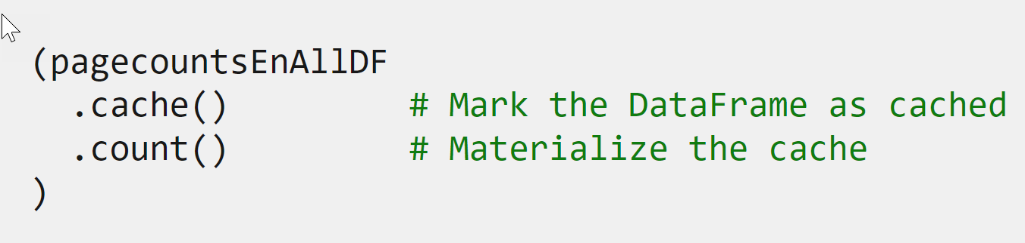
Work with DataFrames in Azure Databricks
Apache Spark DataFrame API reading data in a single command
Mix DataFrame operations
Notes:
Talking points
General info:
The Apache Spark DataFrame API provides a rich set of functions (select columns, filter, join, aggregate, and so on) that allow you to solve common data analysis problems efficiently. DataFrames also allow you to mix operations seamlessly with custom Python, SQL, R, and Scala code. Within the notebook experience in Azure Databricks, files can be read in a single command.
What are DataFrames?
You could view DataFrames as you might see data in Microsoft Excel. It's like a box with squares in it, that organizes data, which we could also refer to as a table of data. It is a single set of two-dimensional data that can have multiple rows and columns in the data. Each row, is a sample of data. Each column is a variable or parameter that describes the data.
What would happen though, if you have thousands and thousands boxes?
A DataFrame creates a data structure and it's one of the core data structures in Spark. In Spark, a DataFrame is seen as a distributed collection of data that is organized into columns that have names.
As you start reading or loading data that is unstructured, semi-structured, or structured. A DataFrame can start transforming that data in order to gain insights. You can use different languages that have different functionalities, like using Spark SQL, PySpark, and others to read and manipulate the data as you require.
Instructor notes and guidance
This slide depicts code that uses the DataFrame API in Apache Spark. Above you find an example of a DataFrame called pagecountsEnAllDF (that is highlighted in the graphic) in the code being created, followed by a mix of DataFrame functions in the same statement. In this example, the results are being cached and has a count being performed. Students will work with DataFrames in the lab themselves, and explore what DataFrames look like, how to create one, and how to work with transformations.

Slide 16
Manipulating and transforming data in Azure Databricks
4
Notes:
Talking Points:
Let’s look at some common manipulation and transformation capabilities with Azure Databricks

Slide 17
Using transformation methods in Azure Databricks
DateTime manipulation
Enabling different DateTime techniques to use across DataFrames
Aggregate Functions
groupBy() function, sum(), count(), avg(), min(), max() functions
Deduplication of Data
Removing duplicates, by ensuring you only keep 1 record
Notes:
Talking points
There are a number of advanced transformation that can be performed in Azure Databricks, here are some common transformations used:
DateTime manipulation:
Sometimes you need to normalize data where different DateTime formats have been used. Within Azure Databricks, you can use different functions to manipulate DateTime and use it across DataFrames.
Aggregate functions:
Aggregating data is one of the more common tasks when working with big data. When there is a question such as what are the total sales, you might think off using an aggregate function. A common used function is the groupBy() function, which groups the Dataset using the specified columns, so that we can run aggregation on them, we can see the aggregation per grouping. Unlike some other transformations, this transformation does not return a DataFrame. In Scala it returns a RelationalGroupedDataset object and in Python it returns a GroupedData objects. So be mindful these will not be persisted until you store the results in a DataFrame.
Deduplication of Data:
In many scenarios, you will likely get data where there are duplicate records. In some of the records, the names could be mixed case, while in others, they are uppercase, which results in a deduplication of records.
Instructor notes and guidance
This slide showcases some example of advanced transformation methods that are commonly seen among customers. In the lab, students will deep-dive into notebook examples of each of the advanced methods mentioned. The students will use the functions to play with DataTime manipulation, aggregate functions and deduplication functions of data.

Slide 18
LAB 3: Data exploration and transformation in Azure Databricks
60 minutes
Notes:
TALKING POINTS​
​
Let’s put this into reality and show you how it works.​
​
All instructions and context are found in this repository​

